Slide 1

Notes:
Oracle in partnership with The Prince’s Trust are hosting a hackathon over the weekend of 30th June & 1st July with an expected number of 100 attendees; open to university students, hobbyist programmers and businesses. We expect a whole host of delegates such as engineers, software developers & architects, designers, analysts, researchers and anyone in between.
A hackathon provides a venue for creativity through technology. People with technical/non-technical backgrounds come together, form teams around a problem or idea, and collaboratively code a unique solution from scratch — these generally take shape in the form of websites, mobile apps and robotics.
The Prince’s Trust have kindly provided us with a large dataset consisting of various different social and professional skills within an age range of people from 11-30 years of age who want to develop. This dataset includes statistics & sources in order for delegates to tackle appropriate challenges.
The aim of the hackathon is to achieve new and innovative approaches to tackle the issues faced by the demographic that the Prince’s Trust data reflects, and to also make a positive impact to society by allowing The Prince’s Trust to use creative solutions to help young people in challenging circumstances.
The delegates will be solving problems, programming overnight and having lots of fun over our 24-hour Hack!
Throughout the event there will be plenty of food provided, prizes to be won, presenting opportunities and the potential of gathering stream analytic data for the hackathon social media coverage.
All proceeds from the event will be donated to The Prince’s Trust.
A great way to raise money for charity. An opportunity to build on the positive & ongoing relationship we have with the Prince’s Trust, as well an opportunity to find new, innovative & creative solutions to the problems faced by the Trust.
A great opportunity to develop, build & sustain new & ongoing relationships with developers. Great recognition & social media presence that Oracle are doing activities & events alongside the open source community. Changing the views and opinions of Oracle in the wider developer community.
Brings new opportunities for Oracle within the wider technology space. A great event to network and share knowledge. New business opportunities as well as to engage with customers after the event in order to set up workshops and build relationships with new customers.
Continues to showcase Oracle’s wider outreach and drive for STEM.
Hackathons are a lot of fun!

Slide 2
Overview
Oracle in partnership with The Prince’s Trust are hosting a hackathon over the weekend of 30th June & 1st July with an expected number of 100 attendees; open to university students, hobbyist programmers and businesses. We expect a whole host of delegates such as engineers, software developers & architects, designers, analysts, researchers and anyone in between.
A hackathon provides a venue for creativity through technology. People with technical/non-technical backgrounds come together, form teams around a problem or idea, and collaboratively code a unique solution from scratch — these generally take shape in the form of websites, mobile apps and robotics.
The Prince’s Trust have kindly provided us with a large dataset consisting of various different social and professional skills within an age range of people from 11-30 years of age who want to develop. This dataset includes statistics & sources in order for delegates to tackle appropriate challenges.
The aim of the hackathon is to achieve new and innovative approaches to tackle the issues faced by the demographic that the Prince’s Trust data reflects, and to also make a positive impact to society by allowing The Prince’s Trust to use creative solutions to help young people in challenging circumstances.
The delegates will be solving problems, programming overnight and having lots of fun over our 24-hour Hack!
Throughout the event there will be plenty of food provided, prizes to be won, presenting opportunities and the potential of gathering stream analytic data for the hackathon social media coverage.
All proceeds from the event will be donated to The Prince’s Trust.

Slide 3
Why?
A great way to raise money for charity. An opportunity to build on the positive & ongoing relationship we have with the Prince’s Trust, as well an opportunity to find new, innovative & creative solutions to the problems faced by the Trust.
A great opportunity to develop, build & sustain new & ongoing relationships with developers. Great recognition & social media presence that Oracle are doing activities & events alongside the open source community. Changing the views and opinions of Oracle in the wider developer community.
Brings new opportunities for Oracle within the wider technology space. A great event to network and share knowledge. New business opportunities as well as to engage with customers after the event in order to set up workshops and build relationships with new customers.
Continues to showcase Oracle’s wider outreach and drive for STEM.
Hackathons are a lot of fun!

Slide 4





Challenges
We’ve developed these challenges based on the underlying issues that the Prince’s Trust members face, as well as what the data set reflects. These are all prevalent matters in modern day society and the hackathon aims to tackle these areas in innovative and creative ways.
There is open source government demographic data available as well as other sources such as Kaggle and ML scripts.
1
2
3
Bullying & Safeguarding
Education & Employment
Mental Health
4
5
Family Areas
Open Challenge

Slide 5
Challenges
1
2
3
Bullying & Safeguarding
Education & Employment
Mental Health
Find correlations and identifiers between different groups in the dataset (A-E) that reflects or indicates that bullying (cyber, physical or emotional etc) or a lack of safe guarding could lead to:
Lower education attainment
Exclusion from school
Substance abuse
Any other category
Use ML algorithms & predictive data analysis to pick up on these factors and to identify the likelihood of bullying based on social behaviour.
Focusing on a group (A-E) of your choice from the dataset, use ML algorithms to perform a full analysis to determine key factors that lead to or prevent people from attaining full time employment or retain full time employment.
For groups A & B focus more on education (school, university, college), upbringing, background as well as open source demographic data. For group D and E the focus will be on wider skills, e.g. soft skills, not taught in education system and contributing factors such as substance abuse, criminal record, personality traits etc.
By focusing on groups A, B, & C, use statistical probability analysis, predictions and ML algorithms to determine at what point the Prince’s Trust need to intervene to stop certain Mental Health conditions developing. For example; trigger or turning points in an individual’s life that leads them to display specific behavioural characteristics such as depression, anxiety etc. What is the best way for the Prince’s Trust to interact with such individuals and suggest coping mechanisms/prevention strategies.

Slide 6
Challenges
4
5
Family Areas
Open Challenge
How likely is it for individuals to be accepted into society & what challenges would they face when being accepted in society, based on the following subgroups;
Refugee & Asylum seekers
Ex-offenders
Single parents
Homeless
Care Leavers
Project how many people that come from these subcategories exhibit traits such as low self esteem, lack of direction in life and/or career. How likely is it that these traits will still be prevalent in their character in the future and what mechanisms can the Prince’s Trust use to change this?
Find the most common issues that exists within each group (A-E). Suggest some methods that can be put in place to prevent them from happening or lessen the impact. What can be done to detect these emerging trends?
Using projection metrics, open source demographic data, political influences & community presence etc, are these existing trends forecasted to get better or worse in the future?

Slide 7
Agenda
Saturday 30th June |  | Sunday 1st July
09:00-10:00 | Arrival, Registration, Networking & Refreshments | 0:00-2:00 | Hack time & Dedicated “Quite hours”
10:00-10:30 | Welcome Presentation from Oracle Agenda, rules, challenges, guidelines, where to obtain the data, event day chatbot, explain scoring criteria, challenge categories & prizes Present examples/ideas of technology & platforms they can use Health & safety guidelines over the weekend | 2:00-3:00 | Break – more food? Mediation & head space break
10:30-11:00 | Presentation from Prince’s Trust meet the ambassadors | 2:00-8:00 | Hack & Dedicated “Quite hours”
11:00-11:20 | Presentation by sponsor | 8:00-9:30 | Breakfast
11:20-12:30 | Pizza/Sandwiches, Snacks & Beer | 9:30-12:00 | Hack time and finalise presentations
12:30-13:30 | Get into teams, idea-a-thon, white-boarding session, look at the dataset | 12:00-13:00 | Lunch
13:30-15:00 | Hack time | 13:00-15:00 | Presentations, Judging & Prizes
15:00-15:30 | Food Break | END OF HACKATHON
15:30-19:00 | Hack time
19:00-20:00 | Pies & Mash, Sandwiches, Snacks, Ice cream truck & fresh air
20:00-23:00 | Hack time
23:00-00:00 | Bingo

Slide 8
Categories & Prizes
Biggest positive impact for the Prince’s Trust
Best Social Media Presence
Most innovative way of presenting the data
Most creative way of processing/manipulating the data
Best Overall Presentation
Paintballing tickets, Go Karting tickets, Spa weekends & Hotel Breaks
Google Homes & Alexas?
Oche

Slide 9

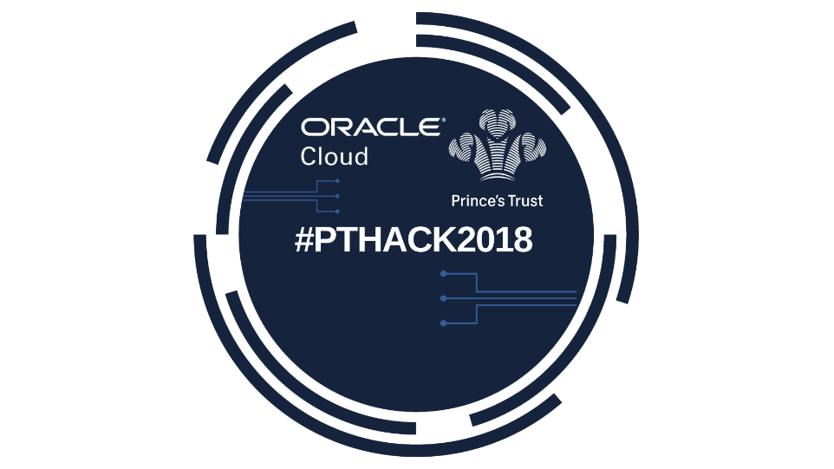

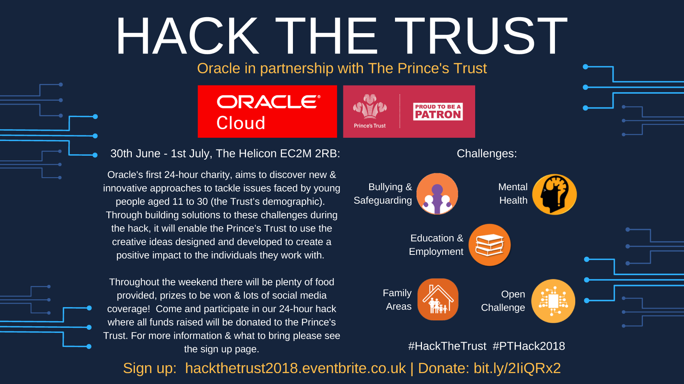
Final Event Creative & Branding

Slide 10

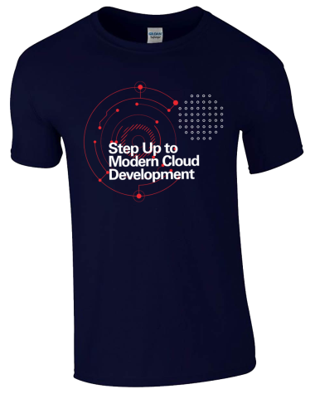
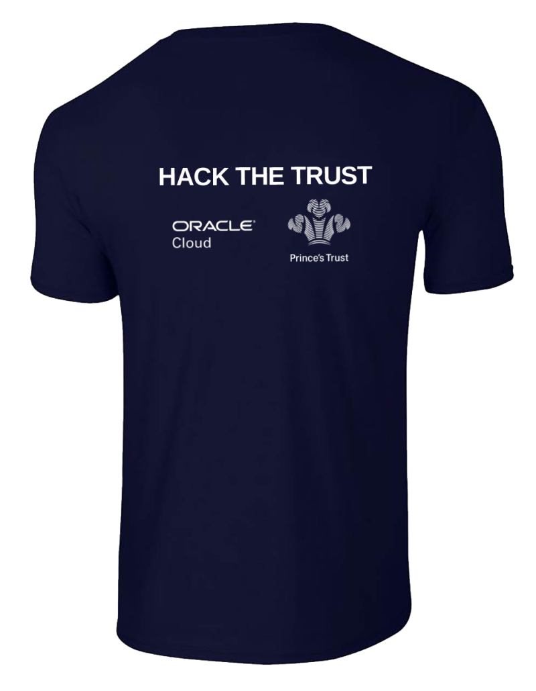

Final Event Creative & Branding
Stickers
Front of T-Shirt
Back of T-Shirt
Gold sponsor logo (1)
located here
Silver sponsor logos
(up to 5) located here
Bronze sponsor logos
(up to 15) located here
Gold sponsor logo
would be located here

Slide 11

Sponsorship Opportunities

Slide 12
Sponsorship Overview
Sponsorship | Number available | Pricing
Gold Sponsor | 1 | £2.5k
Silver Sponsors | 5 | £750
Bronze Sponsors | 15 | £200

Slide 13
Gold Sponsorship (1 package available) - SOLD
Positioned as Gold Sponsor for event
Content
15 - 20min presentation slot
- If sponsor is positioned as already existing partner with Prince’s Trust charity; talk about association with trust. Free to demo company’s products & services.
- Must commit to providing a customer speaker or high-level speaker
Marketing and Branding
Logo placement on the following:
Main sponsor logo on Banner
Main sponsor logo on flyers (A5)
Stickers
Main sponsor logo on t-shirts
Promotion on Eventbrite page
Social media coverage on Twitter, Facebook, LinkedIn, Instagram, Internal Oracle Intranet
Promotion on event chatbot with link to sponsor website
Allow sponsor to bring their own merchandise or goody bags that can be setup on the day for attendees to take away.
Business & Networking Opportunities
Dedicated stand setup throughout the hackathon weekend to promote company.
Invite someone from sponsor to be on judging panel
Offer half-day dedicated workshop to explore use-cases/ideas that come up from the conversations that sponsor have about Oracle services.
2 exhibitor passes to network with customer attendees throughout the two day hackathon event
First refusal to attend workshops and seminars at upcoming Oracle events in 2018
First refusal to be a sponsor at future hackathon events

Slide 14
Silver Sponsorship (5 packages available) – 3 remaining
Positioned as Silver Sponsor for event
Marketing and Branding
Logo placement on the following:
Banner
Flyers (A5)
t-shirts
Promotion on Eventbrite page
Social media coverage on Twitter, Facebook, LinkedIn, Instagram, Internal Oracle Intranet
Promotion on event chatbot with link to sponsor website
Allow sponsor to bring their own merchandise or goody bags that can be setup on the day for attendees to take away.
Business & Networking Opportunities
1 exhibitor pass to network with customer attendees throughout the two day hackathon event
First refusal to attend workshops and seminars at upcoming Oracle events in 2018
First refusal to be a sponsor at future hackathon events

Slide 15
Bronze Sponsorship (15 packages available)
Positioned as Bronze Sponsor for event
Marketing and Branding
Logo placement on the following:
Banner
t-shirts
Social media coverage on Twitter, Facebook, LinkedIn, Instagram, Internal Oracle Intranet
Allow sponsors to bring their own merchandise or goody bags that can be setup on the day for attendees to take away.

Slide 16
Venues & Floorplans
Please note exact locations for sponsor exhibition stands are TBC and the floorplans simply give a draft indication on the exhibition layout.

Slide 17
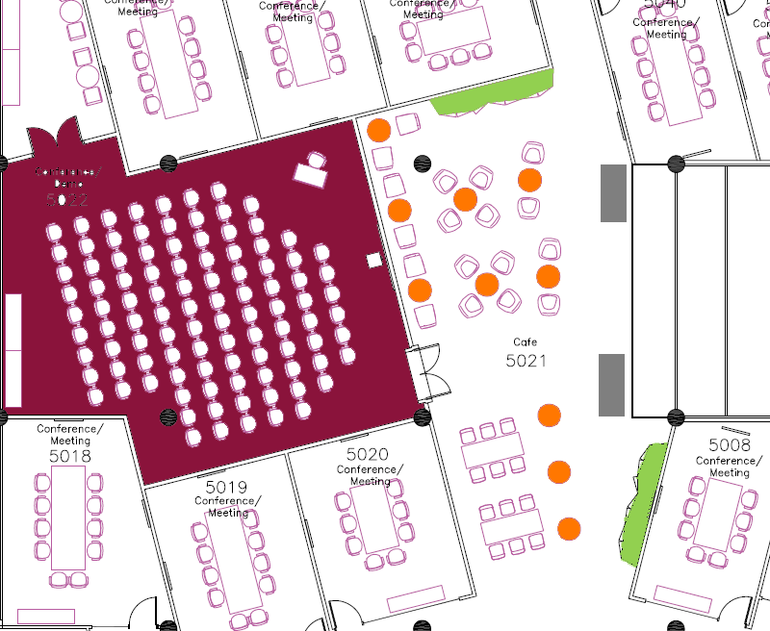
Oracle London City Office, Knightsbridge, 30th June - 1st July
Draft Floorplan
Floor 5, Knightsbridge
(Breakout and Catering Area)
Key:
 | Catering Stations
 | High Top Tables
 | Open Theatre
 | Partner Stands

Slide 18


